Slide 1
Fundamentals of System Analysis and Design
Chapter One:
Basic Concepts in Information System Development

Slide 2
Topics
System Analysis and design, System, Information systems, System thinking
Types and Characteristics of Information Systems
Participants in Information System Development
Roles and qualities of System Analyst
System development methodologies, Processes/Phase

Slide 3
Some basic definitions
Systems Analysis and Design: What is it?
  Systems analysis
    Process of studying an existing system to determine how it works and how it meets user needs
  Systems design
    Process of developing a plan for an improved system, based upon the results of the systems analysis

Slide 4
Basic Definitions cont’d
System analysis and design is a step by step complex method whereby computer based information systems that can perform basic business function are developed and maintained.
It can also be defined as a standard set of activities, methods, best practices, deliverables, and automated tools that stakeholders use to develop and maintain information systems.
System Analysis and Design is used to analyze, design and implement improvements in the functioning of businesses that can be accomplished through use of computerized information systems. Notice the emphasis on business improvement.

Slide 5
Basic Definitions cont’d
SAD is based on two skills/knowledge
  Understanding of organizations objectives, structure and process (domain Knowledge)
  Knowledge of how to exploit information technology for the advantage of the business at hand
Out come of such SAD
  An application software (information systems) to improve users/employee efficiency by improving the business process
What is System in general, information system, in particular?
  A system is a core concept defined as an interrelated set of components with an identifiable boundary, working together for some purpose.

Slide 6
Basic Definitions cont’d
Characteristics of a system (9 characteristics used to describe systems)
  Components - either an irreducible part( the tiniest) or an aggregate of parts (subsystem)
  Interrelated Components- the function of one is tied to the function of the other
  Boundary- the limits of the system with in which the system is contained, and that separates it from other systems. Components within the boundary can be changed.
  Purpose- The components work together to achieve some overall purpose(goal): the system’s reason for existence
  Environment- Everything outside the system’s boundary
  Interfaces- the point at which the system meets its environment
  Input- What the system takes in from the environment to function
  Output- The result of the function of the system
  Constraints- limits to the system in terms of its capacity

Slide 7
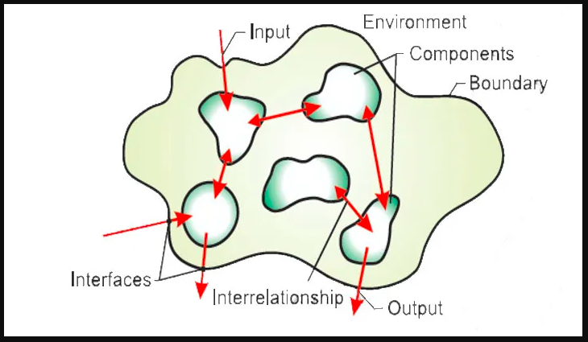
Basic Definitions cont’d

Slide 8
Example
Viewing a car as a system helps us determine what the problem is and fix it by breaking the system down in to its components.
It is also important to consider the relationship one subsystem has with another in doing so.

Slide 9
Exercise
Identify something as a system
Identify and describe its characteristics ( the 9 characteristics discussed)

Slide 10
Other Important system concepts
  Decomposition- being able to break down a system into its components. It also helps to build different parts of the system at different times or by different individuals.
  Modularity- relatively uniform size components or chunks.

Slide 11
Cont…
  Coupling- the extent to which subsystems are dependent on each other. Subsystems should be as much independent from each other as possible.
  Cohesion- the extent to which a module or a subsystem performs a single function. When we have highly cohesive modules each module accomplishes one and only one function. This makes the module reusable in future programs. Take a biological system as an example. It has highly cohesive modules. It is possible to transplant a heart or kidney.
  Loosely Coupled and Highly Cohesive systems are imperative for re-use and maintainability

Slide 12
Cont…
Systems thinking
  Is a mind set or way of viewing a world as a system Actually, systems thinking is just one part of the skills a systems analyst requires
  it helps to see the big picture; it also pays to break problems down to their components to avoid complexity.
  It minimizes the effect of a change in one module on another.
  It emphasizes on the relationship and the process that goes inside rather than constituent parts or just the sum of the parts( “The whole is more than the sum of its parts”). Accordingly,
    “A system is bigger than the sum of its components”

Slide 13
Information system
Is an arrangement of people, data, processes, communication, and information technology that interact to capture, transmit, store, retrieve, manipulate and/or display information needed to support and improve day-to-day operations in a business as well as support the problem solving and decision making needs of management and other users.

Slide 14
Data, Information and Knowledge
Data
  is a raw fact on any thing
  It is representation real world (Objective, fragmented, and in its simplest form) eg 91, 22, 33
Information
  data processed, organized, or structured to provide context and relevance
  Information is data interpreted in a way that it becomes meaningful
    Eg. Yesterday, average temperature in Addis was 15°C.
Knowledge
  The application of data and information to understand concepts, relationships, and principles.
  Knowledge is built from experience, context, and insights.
  is more structured information in the human mind(actionable information)
  involves interpretation, understanding, and experience and is used to make decisions or solve problems.
    Eg: next slide

Slide 15
Data, Information and Knowledge
Example with weather forecasting scenario:
Data:
  Monthly temperature recordings from multiple weather stations around the world (e.g., 29°C in July in Location A, 35°C in July in Location B).
Information:
  The processed data shows that average global temperatures have been steadily increasing over the past 100 years, and the frequency of extreme weather events (e.g., heat waves, hurricanes) has risen.
Knowledge:
  Based on this information, scientists conclude that human activities, particularly the burning of fossil fuels, are contributing to the rise in greenhouse gases, which in turn is leading to global warming. This knowledge is then applied to predict future climate patterns and inform policies aimed at mitigating climate change.

Slide 16
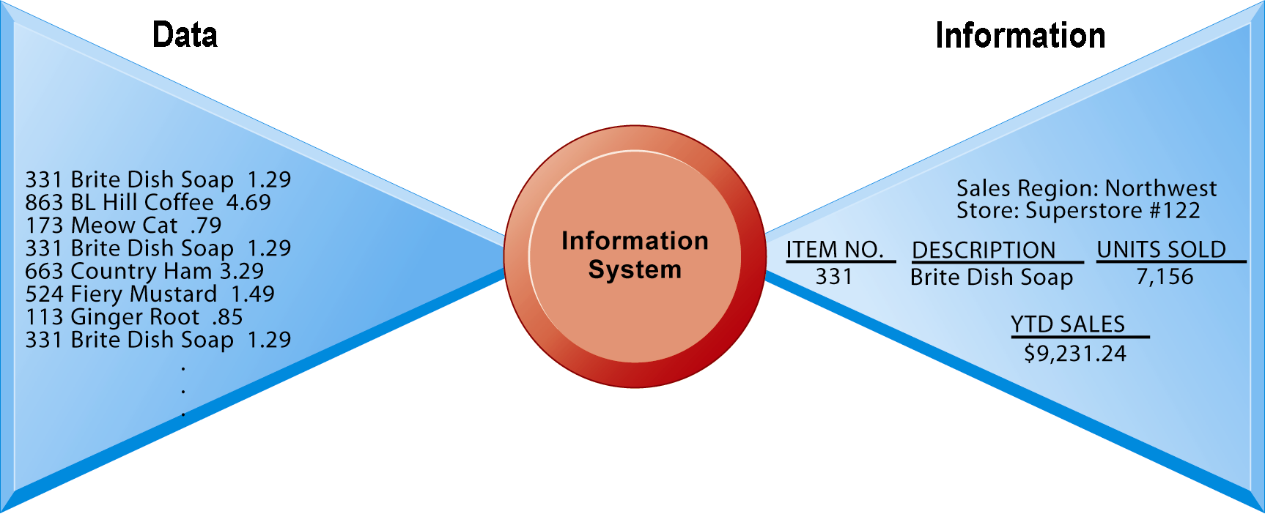
Data and Information
Raw data from a supermarket checkout counter can be processed and organized to produce meaningful information, such as the total unit sales of dish detergent or the total sales revenue from dish detergent for a specific store or sales territory.

Slide 17
Types of information systems
IS can be classified into various types based on their function:
  TPS
  MIS
  DSS
  EIS
  ERPs
  SCM
  CRM
  KMS

Slide 18
Type | Purpose | Examples | Users | Key Features
TPS | Handles and records daily transactions. | Point-of-sale systems, payroll systems | Operational staff, management | High-volume processing, real-time updates, accuracy in repetitive tasks
MIS | Provides routine reports and summaries for decision-making | Sales management, inventory control | Middle managers | Aggregates data from TPS, regular reporting, analysis
DSS | Supports complex decision-making with data analysis. | Financial planning, risk analysis | Senior managers, analysts | Interactive, "what-if" scenarios, supports semi-structured decisions
EIS | Provides high-level information for strategic decisions | Dashboards, KPI reports, trend analysis | Senior executives, top managers | Summarized, visual data, key performance metrics

Slide 19
Type | Purpose | Examples | Users | Key Features
ERPs | Integrates all departments and functions into a unified system.. | SAP, Oracle ERP | Entire organization | Centralized database, modular, covers all business processes
SCM | Manages the flow of goods, information, and finances in supply chains. | Inventory management, vendor management | Supply chain managers, logistics | Real-time data on inventory, orders, and performance
CRM | Manages customer interactions and relationships | Salesforce, HubSpot, Zoho CRM | Sales teams, marketing, support | Tracks customer interactions, manages leads, analyzes customer behavior
KMS | Captures and shares organizational knowledge | Intranets, SharePoint, Wikis | Employees, project teams | Centralized knowledge repository, encourages sharing and collaboration

Slide 20
Other Types of IS Cont’d…
Other Systems
  E-commerce Applications: Business to Customer, Business to Business, and Customer to Customer
  IRS- Information retrieval systems
Business intelligence
  Class of software applications
  Analyze current and historical data to find patterns and trends and aid decision-making
  Used in systems that support middle and senior management
    Data-driven DSS
    Executive support systems (ESS)

Slide 21
Other Types of IS Cont’d…
Executive support systems
  Support senior management
  Address non-routine decisions
    Requiring judgment, evaluation, and insight
  Incorporate data about external events (e.g. new tax laws or competitors) as well as summarized information from internal MIS and DSS

Slide 22
Cot…
Building blocks of IS
  Data- the raw facts used to create useful information.
  Processes- the activities that carry out the mission of the business.
  Interfaces- how the system interfaces(interacts) with its users and other information systems.
  People- experts who design, implement, operate, and maintain the IS, ensuring it meets the organization’s needs. End-users who input data, retrieve information, and use system outputs.

Slide 23
Participants in Information System Development
Usually system development is a team work and project based.
Who do you think are the stakeholders (participants) in IS design and development?
How do each of these stakeholders participate?

Slide 24
Cont…
System owners- pay for the system to be built and maintained.
  They own the system, set priorities for the system, and determine policies for its use. In some cases, system owners may also be system users.
System users- are the people who actually use the system to perform or support the work to be completed.
  System users define the business requirements and performance expectations for the system to be built.

Slide 25
Cont…
System analysts- facilitate the development of information systems and computer applications by bridging the communication gaps that exist between non-technical system owners and users and technical system designers and builders.
System designers- are the technical specialists who design the system to meet users’ requirements. In many cases, system designers may also be system builders.

Slide 26
Cont…
System builders are the technical specialists who construct, test, and deliver the system into operation.
IT vendors and consultants who sell hardware, software and services to businesses for incorporation into their information systems.

Slide 27
Systems Analyst
Professional computer employee who performs analysis and design
Change agent
  Overcome reluctance of users to change
Typical career path
  Programmer
  Programmer / Analyst
  Systems Analyst

Slide 28
Systems Analyst
Functions
Coordination
Schedules and system-related tasks
Personnel
  Manager
  Programmers
  Users
  Vendors of computer equipment

Slide 29
Systems Analyst
Functions
Communication
  Oral presentations
  Written documentation
Planning and design
  Plans and designs new system
  Involved from beginning of project to final implementation of the system

Slide 30
System Analyst
Necessary skills required
  Analytical skills
  Technical skills
  Business skills
  Interpersonal skills
  Attention to details
  Continuous learning

Slide 31
Skills Cont’d…
Analytical skills
  Problem Identification: a problem is the difference between an existing situation and a desired situation. Being able to see the real problem from an organizational perspective.
  Problem-Solving: diagnose systems issues, identify inefficiencies, and propose effective solutions.
    formulating alterative solutions, choosing the best alternative, devising a plan for its implementation
  Requirement Gathering: Expertise in collecting and documenting system requirements from stakeholders.
    Organizational knowledge- how organizations work (Example a payroll system developed for a Government Unit wouldn’t work for a private company)
  Process Mapping: Understand business processes and model them using modeling tools (e.g., DFD, UML, flowcharts, BPMN).
  Systems Thinking: see how different parts of a system interact and affect one another, anticipating impacts of changes.

Slide 32
Skills Cont’d…
Technical skills-
  Understanding of IT Systems: Strong knowledge of hardware, software, networks, and databases.
  Programming Knowledge: Familiarity with programming languages (understand and write scripts (e.g., SQL, Python, Java )
  Data Analysis: Ability to analyze large datasets and generate insights using data analysis tools.
  Database Management: Knowledge of relational databases, SQL, and NoSQL databases for querying and managing data.
  Systems Design: Skills in designing systems architecture, data models, and workflows.
  Knowledge of Software Development Life Cycle (SDLC): Understand methodologies such as Agile, Waterfall, for system development.
  Knowledge of Operating Systems: Proficiency in various operating systems (e.g., Windows, Linux) to evaluate and implement solutions.
  Cloud Computing: Familiarity with cloud platforms (AWS, Azure) for system deployment and integration.
  Cybersecurity Awareness: Understanding of security protocols and risks to ensure systems are secure.

Slide 33
Skills Cont’d…
Business skills
  Business Acumen: Knowledge of industry-specific business processes, objectives, and challenges.
  Project Management: Ability to manage projects, work within timelines, and meet budgets, often working with project management tools like Jira or MS Project.
  Cost-Benefit Analysis: Ability to evaluate the financial implications of system changes and implementations.
  Risk Management: identifying risk in an IS development process and minimizing it. For instance, use of standard or commonly used technology will be less risky.
  Change management: helps people make a smooth transition from one information system to another
  Vendor Management: Skills in working with third-party vendors for system implementations and support.

Slide 34
Skills Cont’d…
Interpersonal skills
  Communication: Strong verbal and written communication skills to bridge concept understanding gap between technical experts and non-technical stakeholders
    Develop interviewing, listening, written and oral presentation skills
  Collaboration: Ability to work with cross-functional teams, including developers, project managers, and business stakeholders.
    Working in a team (team player),
    facilitating groups-guiding groups to work together
  Negotiation: Skills to negotiate system requirements and project scope with various stakeholders.
    Managing expectations- educate pessimists
    Managing setbacks- handling difficult situations/conflicts/disagreements
  Adaptability: Ability to manage change and adapt to shifting business priorities.

Slide 35
Skills Cont’d…
Attention to details
  Documentation: Ability to thoroughly document system requirements, processes, and configurations.
  Quality Assurance: Skill in testing systems to ensure they meet the required specifications and function as expected.
Continuous learning
  Keeping Up with Technology Trends: Staying updated with new technologies, methodologies, and industry best practices to remain effective.

Slide 36
Approaches to Systems Development
Process-Oriented Approach
  the primary focus is on the business processes that the system must support.
    Emphasis: the workflow, actions, and procedures required to complete tasks or deliver services.
    Modeling: involves use of flowcharts, process diagrams (e.g., Business Process Model and Notation, or BPMN), and Data Flow Diagrams (DFDs) to represent and model business processes.
    Functionality-Centric: The system’s functionality is prioritized, ensuring that the processes are performed efficiently.
    Hierarchical Structure: Often, processes are broken down into sub-processes and tasks in a top-down manner.
    Clear Sequence of Steps: The sequence of actions and the flow of information between processes is a key concern

Slide 37
Approaches to Systems Development…
Process-Oriented Approach cont’d
  Well-suited for organizations where workflows are clearly defined and process efficiency is a priority.
  Provides a clear understanding of how different parts of a system interact.
  Helps to identify bottlenecks and inefficiencies in processes that can be optimized through automation.
  May overlook or undervalue the importance of data structure and relationships.
  Not as adaptable if business processes change frequently, requiring re-analysis and re-design of processes.

Slide 38
Approaches to Systems Development…
Common Methodologies for Process-Oriented Approach
  Business Process Reengineering (BPR): A process improvement approach that focuses on redesigning business workflows for better performance.
  Structured Systems Analysis and Design Method (SSADM): Focuses on understanding the data flows and processes within a system but emphasizes processes as the key driver.
  Event-Driven Process Chain (EPC): A method for modeling business processes in enterprise resource planning (ERP) systems.
  Example Use Case: A customer service system where the focus is on improving the workflow of handling service requests, assigning them to support agents, and resolving issues within a certain time frame

Slide 39
Approaches to Systems Development…
Data-Oriented Approach
  the focus is on the data—how it is structured, stored, and related—within the system.
  Emphasis: organization of data, integrity, and management of data across the system, independent of the processes that manipulate that data.
    Business rules depict how an organization captures and processes data
  Data Structure: system is designed around the data being stored, its attributes, relationships, and constraints
  Modeling: Techniques like Entity-Relationship Diagrams (ERDs) or Class Diagrams are used to model the data entities and their relationships.

Slide 40
Approaches to Systems Development…
Data-Oriented Approach cont’d
  Data Integrity and Consistency: Ensuring that data is accurate, reliable, and consistent across the system is a primary concern.
  Data Independence: The system separates the data model from the processes that use the data.
    Changes to processes don't require re-structuring the data.
  Normalization: Data is structured in such a way that redundancy is minimized, and relationships are clearly defined through keys and constraints.

Slide 41
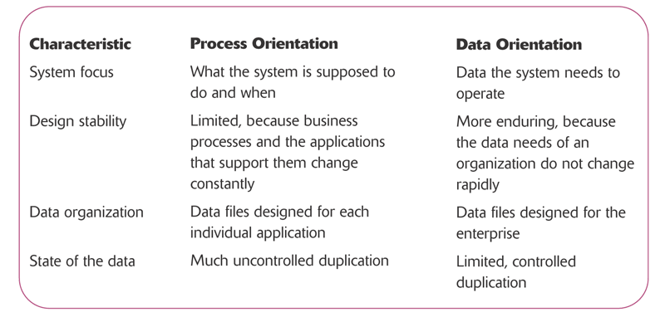
Key differences between Process Oriented and Data Oriented approaches to system Dev’t

Slide 42
System Development Approaches, Methodologies and Phases/Processes
Organizations use a standard set of steps, called a systems development methodology, to develop and support their information systems.
The systems development life cycle (SDLC) is a common, four-step methodology for systems development in many organizations that marks the phases or steps of information systems development

Slide 43
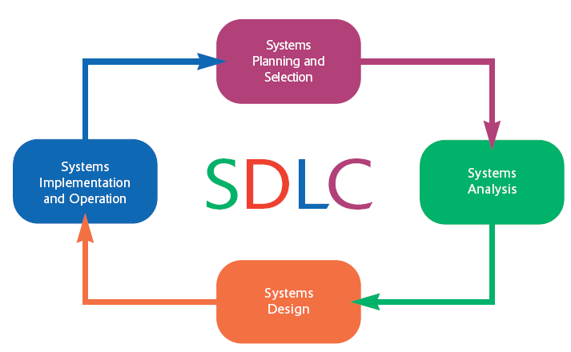

Slide 44
Phase 1: Systems Planning and Selection
The primary activities of this phase are:
  identifying the need for a new or enhanced system and
  Selection of projects that are perceived to meet the objectives of an organization
Information system needs of an organization may result from:
  Requests to deal with problems in current procedures
  The desire to perform additional tasks (or compliance to standards)
  The realization that information technology could be used to capitalize on an existing opportunity

Slide 45
Systems Planning and Selection
Once a project is selected a plan is designed that lays out important issues such as:
  Feasibility study
  Scope
  Schedule
The plan is finally presented to the management to proceed to the next phase.

Slide 46
Phase 2: Systems Analysis
During this phase, the analyst thoroughly studies the organization’s current procedures and the information systems used to perform different tasks.
The activities generally included in the analysis phase are:
  determining the requirements of the system
  Requirement structuring and elimination of redundancies
  generating alternative initial designs to match the requirements
The output of the analysis phase is a description of the alternative solution recommended by the analysis team

Slide 47
Phase 3: Systems Design
During systems design, analysts convert the description of the recommended alternative solution into logical and then physical system specifications.
Logical design is not tied to any specific hardware and systems software platform.
During physical design decision is made regarding:
  programming language
  database systems
  hardware platform
  operating system, and
  network environment the system will run under.
The final product of the design phase is the physical system specifications

Slide 48
Phase 4: Systems Implementation and Operation
During systems implementation and operation, you turn system specifications into a working system that is tested and then put into use.( a system in production, a deployed system)
Implementation includes coding, testing, and installation.
During the operation stage, programmers make the changes that users ask for and modify the system to reflect changing business conditions.

Slide 49
IS Development Methods
The Most prominent methodologies for modeling and designing systems:
  Structured methodologies
  Object-oriented development
  Agile/Adaptive Methods
Structured methodologies
  Structured: Techniques are step-by-step, progressive
  Process-oriented: Focusing on modeling processes or actions that manipulate data
  Separate data from processes

Slide 50
Development Methods Cont’d…
Object is basic unit of systems analysis and design
  Object:
    Combines data and the processes that operate on those data
    Data encapsulated in object can be accessed and modified only by operations, or methods, associated with that object
Object-oriented modeling based on concepts of class and inheritance
  Objects belong to a certain class and have features of that class
  May inherit structures and behaviors of a more general, ancestor class

Slide 51
OO vs Structured Methods
More iterative and incremental than traditional structured development
  Systems analysis: Interactions between system and users analyzed to identify objects
  Design phase: Describes how objects will behave and interact; grouped into classes, subclasses and hierarchies
  Implementation: Some classes may be reused from existing library of classes, others created or inherited
Because objects are reusable, object-oriented development can potentially reduce time and cost of development

Slide 52
Alternative approaches to development
Prototyping
joint application design (JAD)
rapid application development (RAD)
participatory design (PD)
Agile Methodologies

Slide 53
Prototyping
Prototyping is the process of designing and building a scaled-down but working version of a desired system
The key advantages of the prototyping technique are:
  it involves the user in analysis and design
  it captures requirements in concrete, rather than verbal or abstract form

Slide 54
Joint Application Design
joint application design (JAD) is a process the purpose of which is to structure the requirements determination phase of the analysis and the reviews that occur as part of the design
Users, managers, and systems developers are brought together for a series of intensive structured meetings run by a JAD session leader

Slide 55
Rapid Application Development
Rapid application development (RAD) is a Systems development methodology created to radically decrease the time needed to design and implement information systems.
Focus is more on system functionality and user interface requirements at the expense of detailed business analysis and concern for system performance issues

Slide 56
Participatory Design
Participatory design (PD) emphasizes the role of the user much more than traditional techniques do, such as structured analysis and structured design
Each user has an equal voice in determining system requirements and in approving system design

Slide 57
Agile Methodologies
Agile Methodologies a family of development methodologies characterized by
  short iterative cycles and extensive testing
  active involvement of users for establishing, prioritizing, and verifying requirements and
  a focus on small teams of talented, experienced programmers.
    Teams usually are focused and may include SME, Requirements Engineers, Developers(Programmers)

Slide 58
Computer-Aided Software Engineering (CASE) Tools
Computer-aided software engineering (CASE) refers to automated software tools used by systems analysts to develop information systems.
The general types of CASE tools include:
  Diagramming tools
  Computer display and report generators
  Documentation generators
  Code generators

Slide 59
Benefits of Systems Analysis and Design
  Better alignment of the system with business needs
    Understanding requirements
    Minimizing mismatch: proper analysis helps to avoid building unnecessary features, this avoids redesign cost
  Improved system quality and reliability
    Detailed analysis to identify issues and address them at design level leads to fewer bugs during post implementation maintenance
    Rigorous testing of individual components and the system as a whole ensures better reliability
    Analyzing both functional and non-functional requirements results in a robust system that can handle real world challenges

Slide 60
Benefits…
  Creates an opportunity to optimize resource (cost and time) by identifying problems early
    By investing time in the analysis phase, potential challenges are identified early preventing costly revisions later
    Leads to fewer surprises during development, keeping the project on budget and on time
    Well documented requirements and structured design prevents scope creep, reduces unnecessary rework and keeps development time in check
    Clear plans for the system’s architecture and work flow enables the team to allocate resources (time, people, technology) more efficiently

Slide 61
Benefits…
  Clear communication between stakeholders and developers
    SAD encourages use of visual tools such as data flow diagram (DFD) and Entity relationship diagrams (ERD) to communicate systems requirements and processes; such tools help to bridge the gap between non-technical stakeholders and technical developers
    Regular feedback loops ensure alignment of expectations and any discrepancies are addressed promptly

Slide 62
Benefits…
  Scalability and Flexibility
    Systems are often designed in a modular way, allowing future expansion and improvement without having to rework the entire system
    A well designed system is easy to upgrade and to maintain
  Enhance user experience
    SAD involves user centric design
  Improved documentation and training
    SAD produces extensive documentation that serves as a valuable reference for developers and users
    Well designed systems are easier to explain and train

Slide 63
End of Chapter Questions
How would you define a system in your own words? Can you give an example of a system (with 9 characteristics) you interact with daily?
How would you explain systems thinking to someone unfamiliar with it?
If a company is struggling with disconnected HR management, procurement processes, and other processes what type of information system would you recommend to integrate these functions and improve overall efficiency? Why?
How do the data-oriented and process-oriented approaches differ? Can you explain how each approach connects to both structured and object-oriented development methods?
Explain at least two alternative approaches to IS development?

Slide 64
End of Chapter One

